Slide 1
Philosophy of the Life Cycle Approach
Presented by:
Mary Teegee-Gray, Executive Director of Child and Family Services
Joan Conlon, Director of Child Safety
Our Children Our Way: Webinar
November 25, 2024

Slide 2
Carrier Sekani by Design
CSFS
Health Services
Data & Infotech
Legal
Child & Family
Research
Housing
“With the guidance of our elders, Carrier Sekani Family Services is committed to the healing and empowerment of First Nations Families by taking direct responsibility for: health, social, legal, and housing services for First Nations people residing in Carrier and Sekani territory."

Slide 3
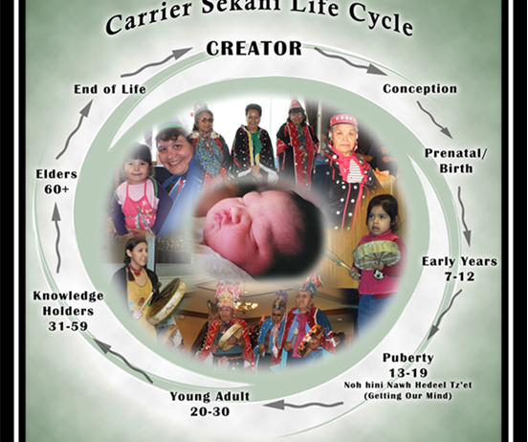
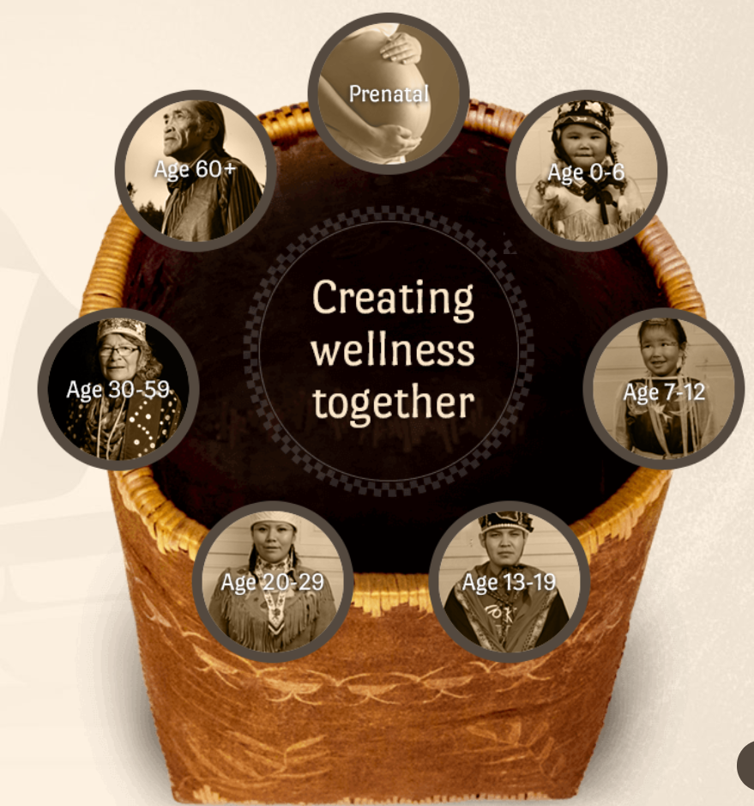
Carrier Sekani Life Cycle
Approach

Slide 4
Carrier Sekani Life Cycle Approach
Employs a holistic framework, considering the safety of a child within their ecological and personal contexts.
Acknowledges the interconnectedness of these contexts, recognizing that ensuring a child’s safety requires a comprehensive approach.
Emphasizes that children and their parents cannot be separated from the well-being of their communities.
Community Well-being
Family Well-Being
Child Well-Being
Safety (emotional, physical, cultural, psychological)

Slide 5
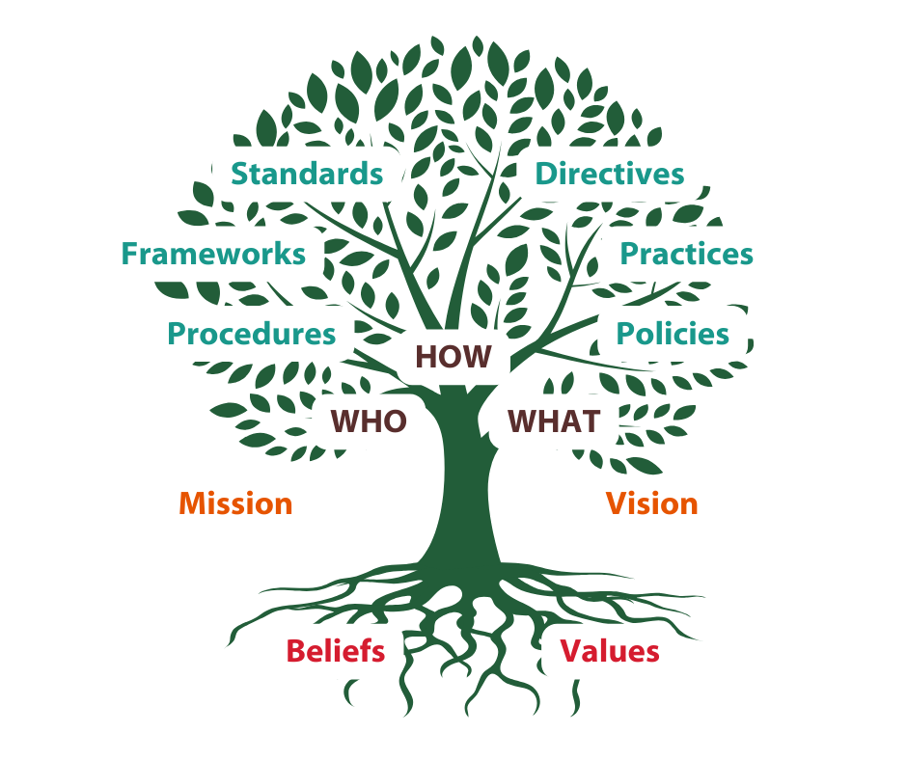

Values & Beliefs

Slide 6
Adapting Frameworks & Pathways
Carrier Sekani Practice & Policy Framework
Pathways to Development
Gathering the Circle
Listening, Assessing and Finding Solutions
Creating Security, Well-Being, & Belonging
Keeping the Circle Strong
Good Policies
Good Legislation
Culturally Safe Approaches
Good Practice
Better Outcomes for Indigenous Children and Families
Informed by the Aboriginal Policy and Practice Framework (APPF)

Slide 7

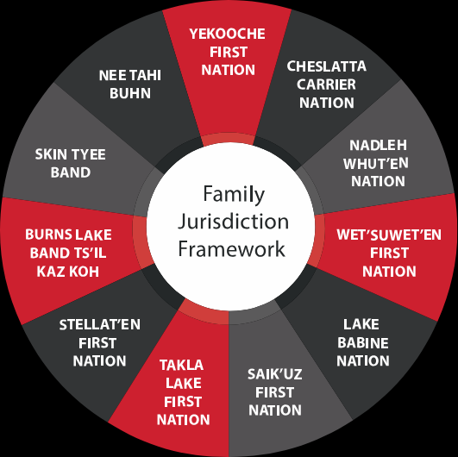
“Yinka Dene Tsinli too udsoo deh kah”
Cultural Continuity
Prevention Services & Intervention
Child Safety &
Well-being
Parenting Support & Services
Child and Youth
Programs
Community
Well-being

Slide 8


Early Childhood Development
Dawne Persson, Director of Early Childhood Development
dawne@csfs.org

Slide 9
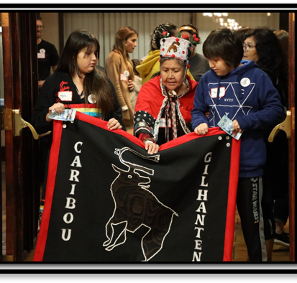
Youth Services
Kayla Brownscombe, Director of Youth Services
kbrownscombe@csfs.org

Slide 10

Mental Health and Wellness Services
Marilyn Janzen, Director of Mental Health and Wellness
mjanzen@csfs.org

Slide 11

Child Safety & Wellbeing
Joan Conlon, Director of Child Safety
jconlon@csfs.org

Slide 12


Jurisdiction – the authority to make decisions about children and families
A MODEL FOR THE ASSERTION OF AUTHORITY FOR CHILDREN AND FAMILIES
How we sorted the work
The most important part of reasserting authority
The steps in ensuring the law and regulations continue to serve the communities
CARRIER SEKANI CHILD AND FAMILY SERVICES ACT

Slide 13
Data Governance/Information Management
Ensuring that all CSFS clients have the rights to:
Confidentiality
Secure storage of personal information by CSFS
Clarity on who has access to their personal information and why
Understand how their information is/has been used
Understand how and when their personal information is shared
Right to raise concerns regarding the privacy or handling of their personal information

Slide 14

Standards of Service and Measurement
Well-being is unique to each person and to where and how they experience their lives.
  Specific to culture of the community, family and circumstances
  Illustrated through the eyes of each child, family, and community member

Slide 15
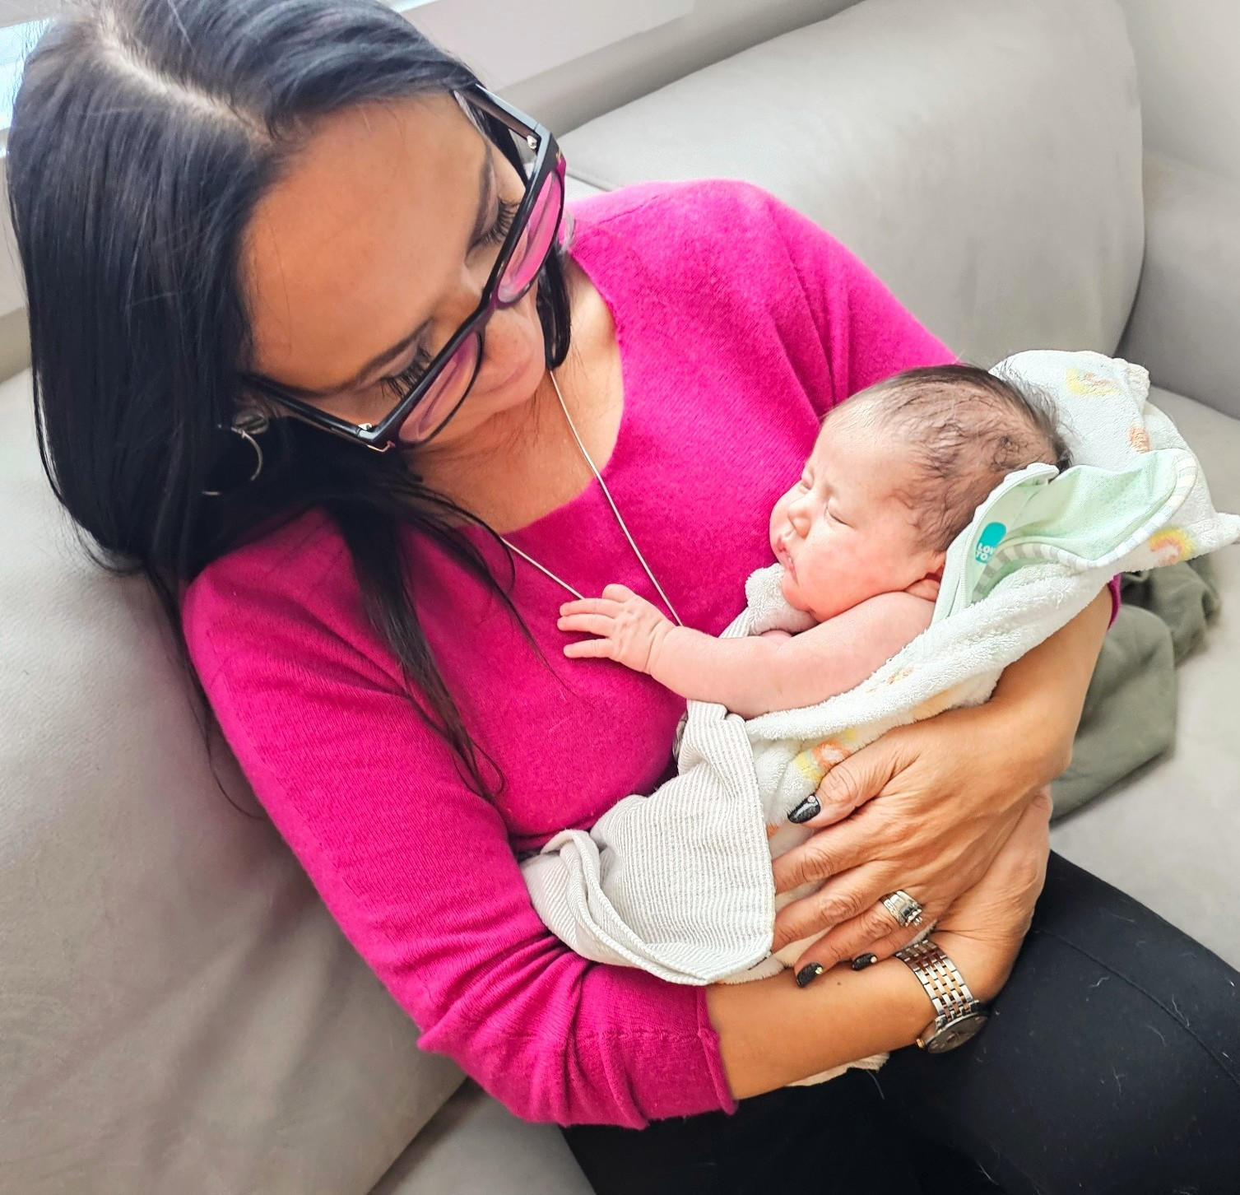
Importance of Life Cycle
Healthy baby= healthy parent= healthy community= healthy Nation
A child’s fullest potential:
  What makes a healthy child? They know who they are, where they come from and have support to reach their goals. Live in culturally rich environments.

Slide 16

“Children have always been at the center of the circle of life, the center of the circle of caring among Indigenous people across Canada. Children do not belong to parents; each child is a unique gift from the creator to be cherished, protected and nurtured into being respectful of all living things.” Anonymous

Slide 17

Practice Differently

Slide 18
Audience Questions

Slide 19
Mussi cho

