Slide 1

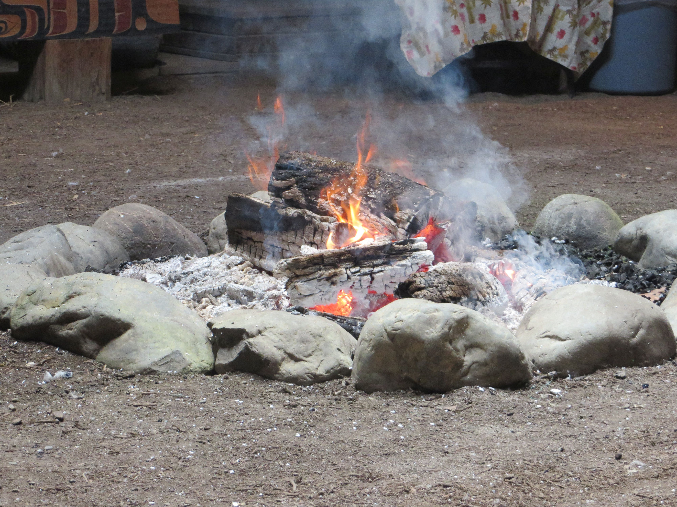
UNDRIP 101
Implementing the UN Declaration on the Rights of Indigenous Peoples in Child and Family Services

Slide 2
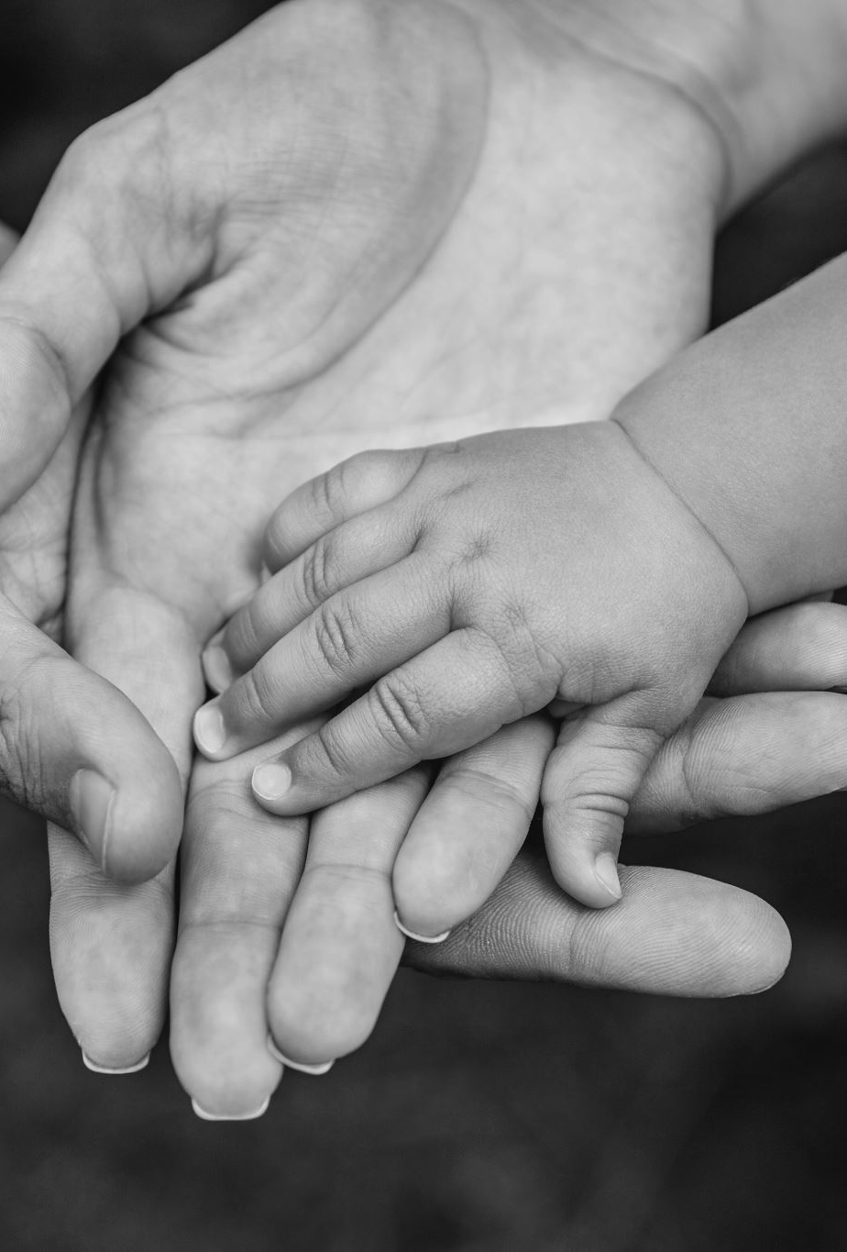
Presentation Overview
Overview of Indigenous rights in Canada and key differences between UNDRIP and Aboriginal rights under s. 35 of the Constitution
Background and History of UNDRIP
Domestic Implementation of UNDRIP in Canada
UNDRIP and Child and Family Services
Strategies for Implementing UNDRIP in Child and Family Services
Recap and Questions

Slide 3
Introduction: Terminology
Indigenous rights – inherent rights held by Indigenous peoples
Aboriginal Rights – judge made rights (ie: hunting, fishing, title to lands)
Indigenous Laws – legal orders created by Indigenous Nations and governments, past and present
Aboriginal Law – body of Canadian law that regulates the relationship between the Crown and Aboriginal Peoples
Aboriginal Peoples – In Canadian domestic law, refers to First Nations, Inuit and Metis
Inherent Rights Holders – Indigenous peoples who hold inherent title and rights
Indigenous Governing Bodies – term used in legislation to recognize Indigenous governments, as self-determined by Indigenous peoples.

Slide 4
Inherent Rights
Arise from the pre-existing use and occupation of their lands and practiced their cultures long before colonization and the formation of Canada as a colonial state.
Includes the right of self-government, and the right of Indigenous peoples to maintain and develop their cultural practices, languages, spiritual beliefs, and knowledge systems.

Slide 5

Section 35 of the Constitution Act, 1982
35(1) The existing aboriginal and treaty rights of the aboriginal peoples of Canada are hereby recognized and affirmed.
(2) In this Act, aboriginal peoples of Canada includes the Indian, Inuit and Métis peoples of Canada.
(3) For greater certainty, in subsection (1) treaty rights includes rights that now exist by way of land claims agreements or may be so acquired.
(4) Notwithstanding any other provision of this Act, the aboriginal and treaty rights referred to in subsection (1) are guaranteed equally to male and female persons.”

Slide 6
Background: History of UNDRIP
International human rights document adopted by UN in 2007
Result of more than two decades of deliberations between Indigenous peoples and member states
Represents a compromise between Indigenous peoples and member states

Slide 7
Background: Canada’s Adoption of UNDRIP
Adopted by Canada in 2010 with reservations:
“The Declaration is an aspirational document which speaks to the individual and collective rights of Indigenous peoples, taking into account their specific cultural, social and economic circumstances.”
May 2016, Canada announced its acceptance of UNDRIP without qualification:
“I’m here to announce, on behalf of Canada, that we are now a full supporter of the Declaration without qualification. We intend nothing less than to adopt and implement the declaration in accordance with the Canadian Constitution .”

Slide 8
UNDRIP Overview
Establishes a universal framework of minimum standards for the survival, dignity and well-being of the indigenous peoples of the world.
Emphasizes self-determination, autonomy, and participation of Indigenous peoples in decisions that affect them.
Does not create new rights, but affirms the pre-existing and inherent rights of Indigenous Peoples worldwide
Collective and individual rights
Is not s. 35

Slide 9
Core Principles
Self-Determination: Indigenous peoples have the right to freely determine their political status and freely pursue their economic, social, and cultural development.
Cultural Rights: Indigenous peoples have the right to maintain and strengthen their distinct cultural practices and traditions.
Land and Resources: Indigenous peoples have the right to the lands, territories, and resources which they have traditionally owned, occupied, or otherwise used.
Consultation and Consent: Indigenous peoples have the right to be consulted in good faith before any project affecting their lands or rights is implemented.

Slide 10




Domestic Implementation: Legislation
Federal
United Nations Declaration on the Rights of Indigenous Peoples Act into law in June 2021
Federal Act Respecting First Nations, Inuit and Metis children, youth and families
British Columbia
Passed the Declaration on the Rights of Indigenous Peoples Act into law in November 2019
Bill 38: Indigenous Self-Government in Child and Family Services Amendment Act
Other Jurisdictions
NWT: United Nations Declaration on the Rights of Indigenous Peoples Implementation Act (2023)
Manitoba: The Path to Reconciliation Act (2016)
Ontario: reference to UNDRIP in the preamble of the Supporting Children, Youth and Families Act

Slide 11
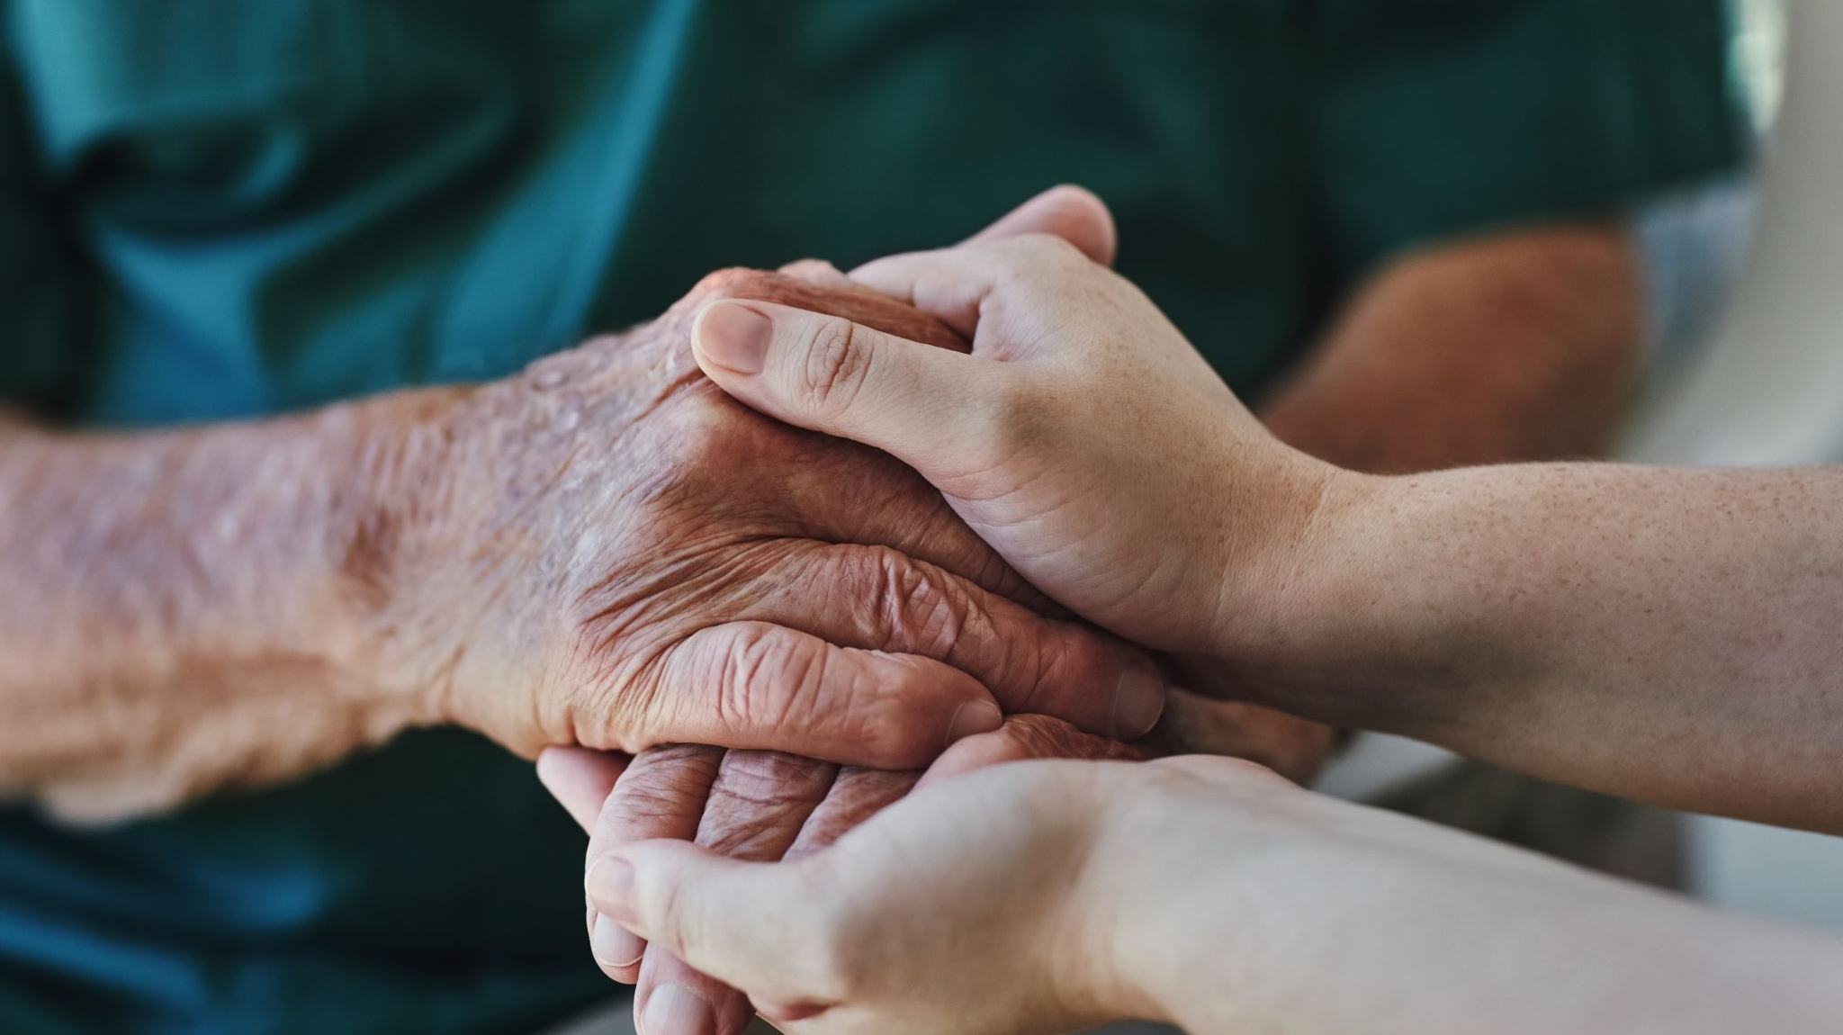
Bill 38: Indigenous Self-Government in Child and Family Services Amendment Act
Created amendments to the Child, Family and Community Services Act and the Adoption Act, which, in part:
  Affirm the right of self-government: requiring both Acts to be interpreted in and administered in accordance with the inherent right of self-government, as recognized and affirmed by s. 35 and UNDRIP.
  Acknowledgement of FPIC: requiring a Director to “consult and cooperate” with Indigenous governments prior to placing an Indigenous child for adoption.
  Shared Decision Making: providing that Indigenous Governing Bodies can enter into shared decision-making agreements with a Minister or Director.
  Cultural preservation and continuity: requiring the preservation and continuity of an Indigenous child’s cultural identity and ties to be at the forefront.

Slide 12
UNDRIPA and DRIPA Action Plans
UNDA Action Plan
Continue to implement the Act respecting First Nations, Inuit and Métis children, youth and families which affirms the inherent right of self-government, including jurisdiction in relation to child and family services, and sets minimum standards in relation to the delivery of culturally appropriate and Indigenous led services with the aim to reduce the number of Indigenous children in care and ensure they remain connected to their families, communities and culture. (Indigenous Services Canada)
DRIPA Action Plan
4.16 Co-develop a B.C.-specific fiscal framework, in partnership with First Nations, Métis and Inuit, and in consultation with key Indigenous organizations, to support and move forward with jurisdiction over child and family services. (Ministry of Children and Family Development)
4.17 In collaboration with B.C. First Nations and Métis Peoples, and Inuit, continue implementing changes to substantially reduce the number of Indigenous children and youth in care through increased prevention and family support services at all stages of contact with the child welfare system. (Ministry of Children and Family Development)

Slide 13

Domestic Implementation: Case Law
First Nations Child & Family Caring Society of Canada et al. v. Attorney General of Canada (Minister of Indigenous and Northern Affairs Canada) Canada), 2018 CHRT 4, at para. 81:
“Furthermore, the Panel believes that national legislation such as the CHRA must be interpreted so as to be harmonious with Canada’s commitments expressed in international law including the UNDRIP.”

Slide 14
Federal Act
Purpose
8 The purpose of this Act is to
  (a) affirm the inherent right of self-government, which includes jurisdiction in relation to child and family services;
  …
  (c) contribute to the implementation of the United Nations Declaration on the Rights of Indigenous Peoples.
Recognition of Inherent Rights
18(1) The inherent right of self-government recognized and affirmed by section 35 of the Constitution Act, 1982 includes jurisdiction in relation to child and family services, including legislative authority in relation to those services and authority to administer and enforce laws made under that legislative authority.

Slide 15
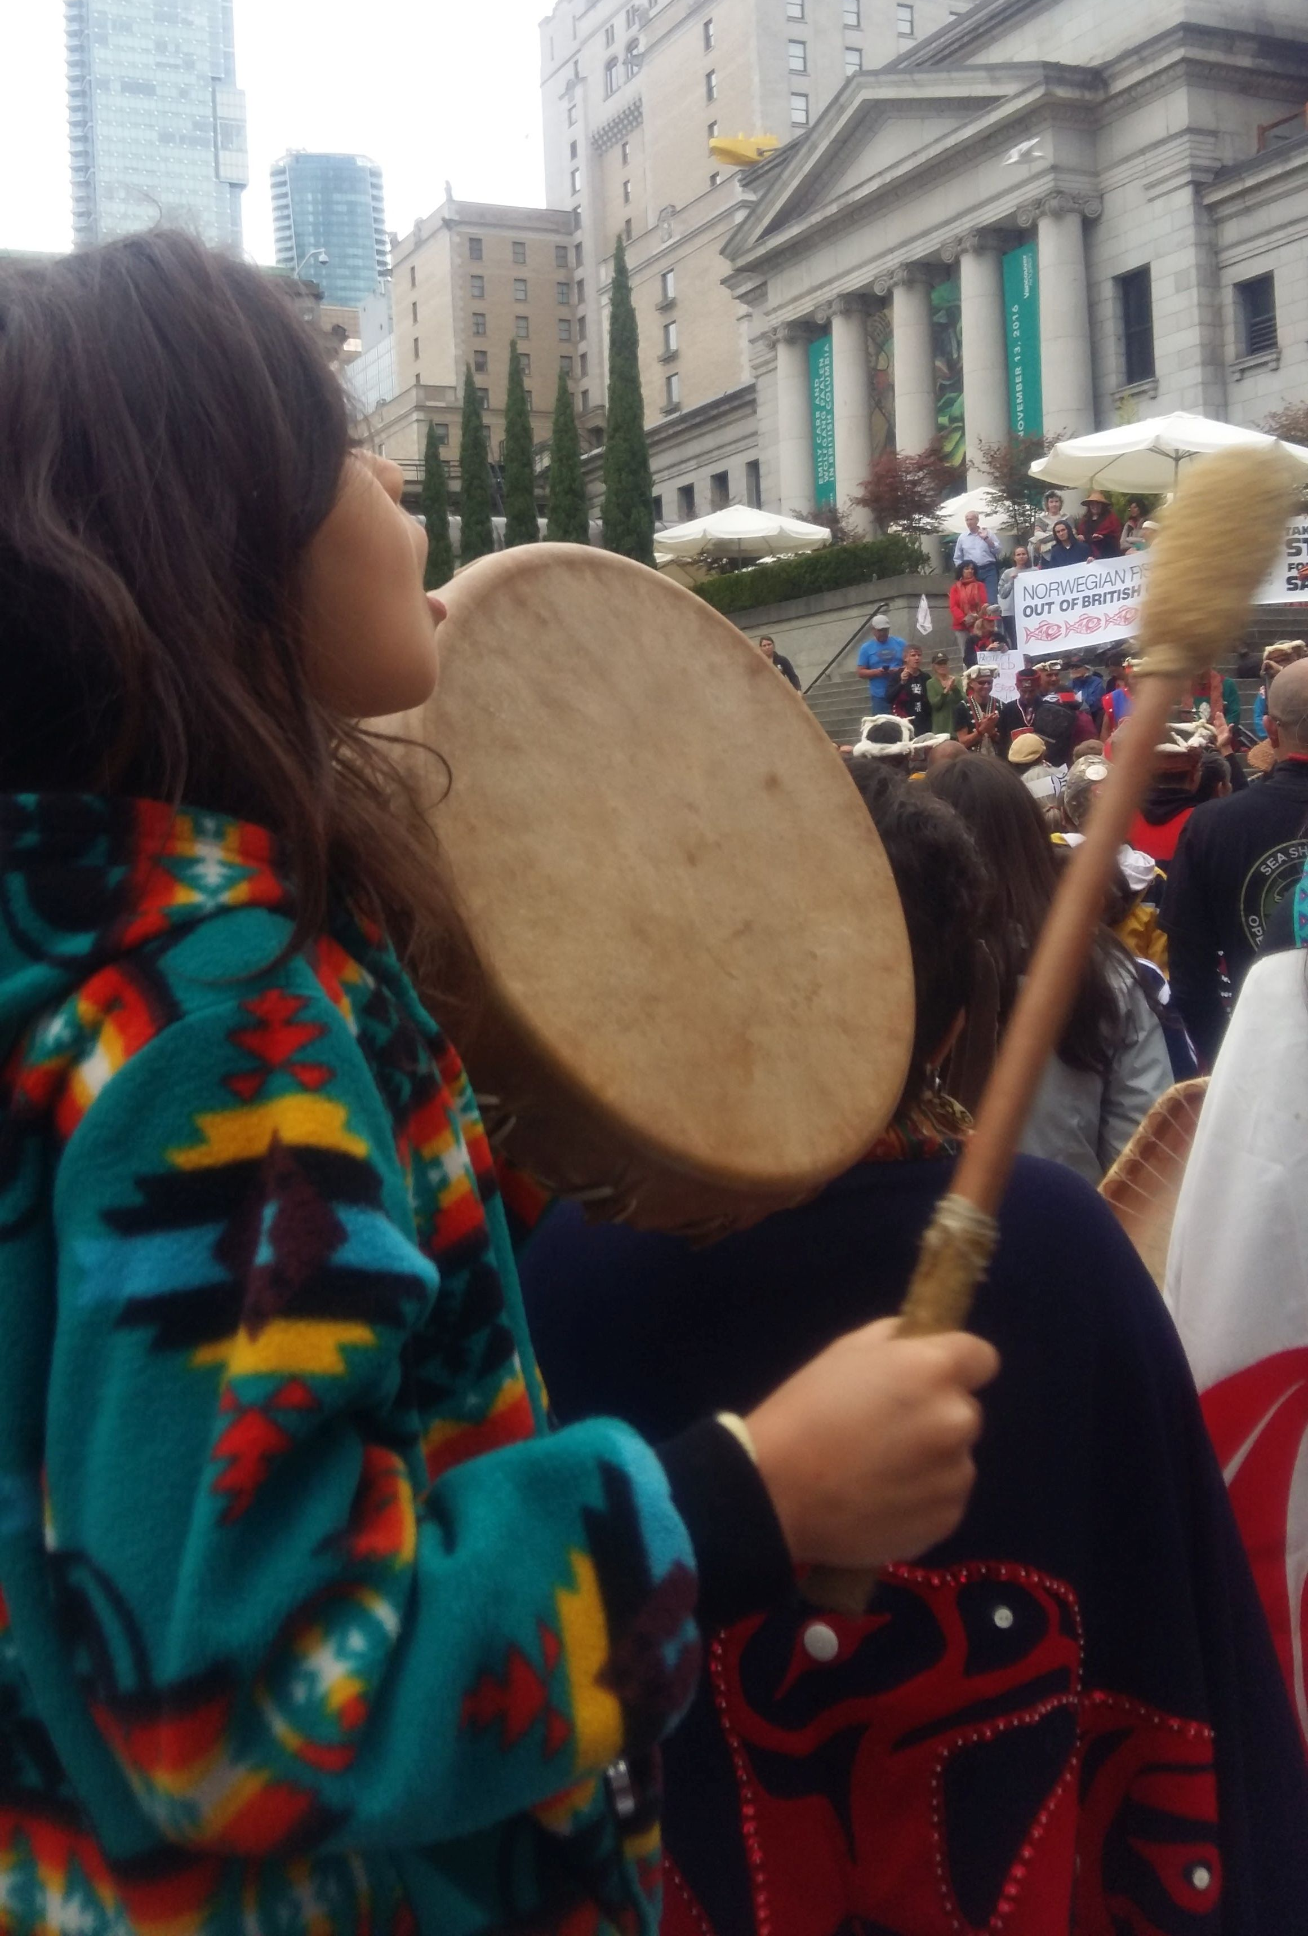
Domestic Implementation: Case Law
Reference re An Act respecting First Nations, Inuit and Métis children, youth and families, 2024 SCC 5
The Supreme Court of Canada said that the Federal Act:
  Incorporates Canada’s commitment under UNDRIP into Canada’s positive law;
  Is likely to make aspects of Canadian law more compatible with UNDRIP; and
  Canada is obligated to interpret the concrete implementation measures of the Federal Act in accordance with UNDRIP.

Slide 16

Case Law
Director and R., 2022 BCPC 15
[19] The ARFNIM is relatively new federal legislation directed at Indigenous children and families. From the preamble, the Federal government commits to implementing the United Nations Declaration on the Rights of Indigenous Peoples; recognizes the legacy of resident schools and the harm, including intergenerational trauma, caused to Indigenous peoples by colonial practices; and breathes life into the Truth and Reconciliation Commissions call to action for all governments to work together with respect to the welfare of Indigenous children by enacting federal legislation that establishes national standards for the welfare of Indigenous children.
British Columbia (Children and Family Development) v. R.T., 2024 BCPC 41
[54] The United Nations Declaration on the Rights of Indigenous Peoples, G.A. Res. 61/295, (hereinafter referred to as “UNDRIP”) Articles 9, 11 and 14.3 guarantee Indigenous people the right to belong to their community, practice their cultural traditions and, for Indigenous children in particular, the right to have access to an education in their own culture. The rights afforded by UNDRIP are human rights and are incorporated in Canadian law. See Reference Case at paragraph 15 and Declaration on the Rights of Indigenous Peoples Act S.B.C c.44.
SK v Alberta (Child, Youth and Family Enhancement Act, Director),2022 ABPC 144:
[23] Finally, Canada has recently enacted the United Nations Declaration on the Rights of Indigenous Persons Act, S.C. 2021, c. 14 (UNDRIPA) affirming the articles of the international convention called the United Nations Declaration on the Rights of Indigenous Persons (UNDRIP). Article 8 says: “(e)very indigenous individual has the right not to be subjected to forced assimilation or destruction of their culture.” This and other articles of the UNDRIPA are relevant and have application to the child protection schemes in Canada and are particularly relevant to private guardianship applications because of the risks of assimilation inherent in the adoption of Indigenous children, particularly by non-Indigenous persons.

Slide 17
Key Provisions related to Child & Family Wellbeing
Art. 7.2: Indigenous peoples have the collective right to live in freedom, peace and security as distinct peoples and shall not be subjected to any act of genocide or any other act of violence, including forcibly removing children of the group to another group
Art. 8.1: Indigenous peoples and individuals have the right not to be subjected to forced assimilation or destruction of their culture.
Art. 8.2: States shall provide effective mechanisms for prevention of, and redress for: Any action which has the aim or effect of depriving them of their integrity as distinct peoples, or of their cultural values or ethnic identities; Any form of forced population transfer which has the aim or effect of violating or undermining any of their rights; Any form of forced assimilation or integration
Art. 12: Indigenous peoples have the right to manifest, practice, develop and teach their spiritual and religious traditions, customs and ceremonies;

Slide 18
Key Provisions related to Child & Family Wellbeing
Art. 21(1): Indigenous peoples have the right, without discrimination, to the improvement of their economic and social conditions, including, inter alia, in the areas of education, employment, vocational training and retraining, housing, sanitation, health and social security.
Art. 21(2): States shall take effective measures and, where appropriate, special measures to ensure continuing improvement of their economic and social conditions. Particular attention shall be paid to the rights and special needs of indigenous elders, women, youth, children and persons with disabilities.
Art. 22(1): Particular attention shall be paid to the rights and special needs of indigenous elders, women, youth, children and persons with disabilities in the implementation of this Declaration.
Art. 22(2): States shall take measures, in conjunction with indigenous peoples, to ensure that indigenous women and children enjoy the full protection and guarantees against all forms of violence and discrimination.

Slide 19
Key Provisions related to Jurisdiction
Art. 3: Indigenous peoples have the right to self-determination. By virtue of that right they freely determine their political status and freely pursue their economic, social and cultural development
Art. 5: Indigenous peoples have the right to maintain and strengthen their distinct political, legal, economic, social and cultural institutions, while retaining their right to participate fully, if they so choose, in the political, economic, social and cultural life of the State
Art. 33(1): Indigenous peoples have the right to determine their own identity or membership in accordance with their customs and traditions.
Art. 34: Indigenous peoples have the right to promote, develop and maintain their institutional structures and their distinctive customs, spirituality, traditions, procedures, practices and, in the cases where they exist, juridical systems or customs, in accordance with international human rights standards.

Slide 20
Key Provisions related to Shared Decision Making
Art. 18: Indigenous peoples have the right to participate in decision-making in matters which would affect their rights, through representatives chosen by themselves in accordance with their own procedures, as well as to maintain and develop their own indigenous decision-making institutions.”
Art. 19: States shall consult and cooperate in good faith with the indigenous peoples concerned through their own representative institutions in order to obtain their free, prior and informed consent before adopting and implementing legislative or administrative measures that may affect them.

Slide 21
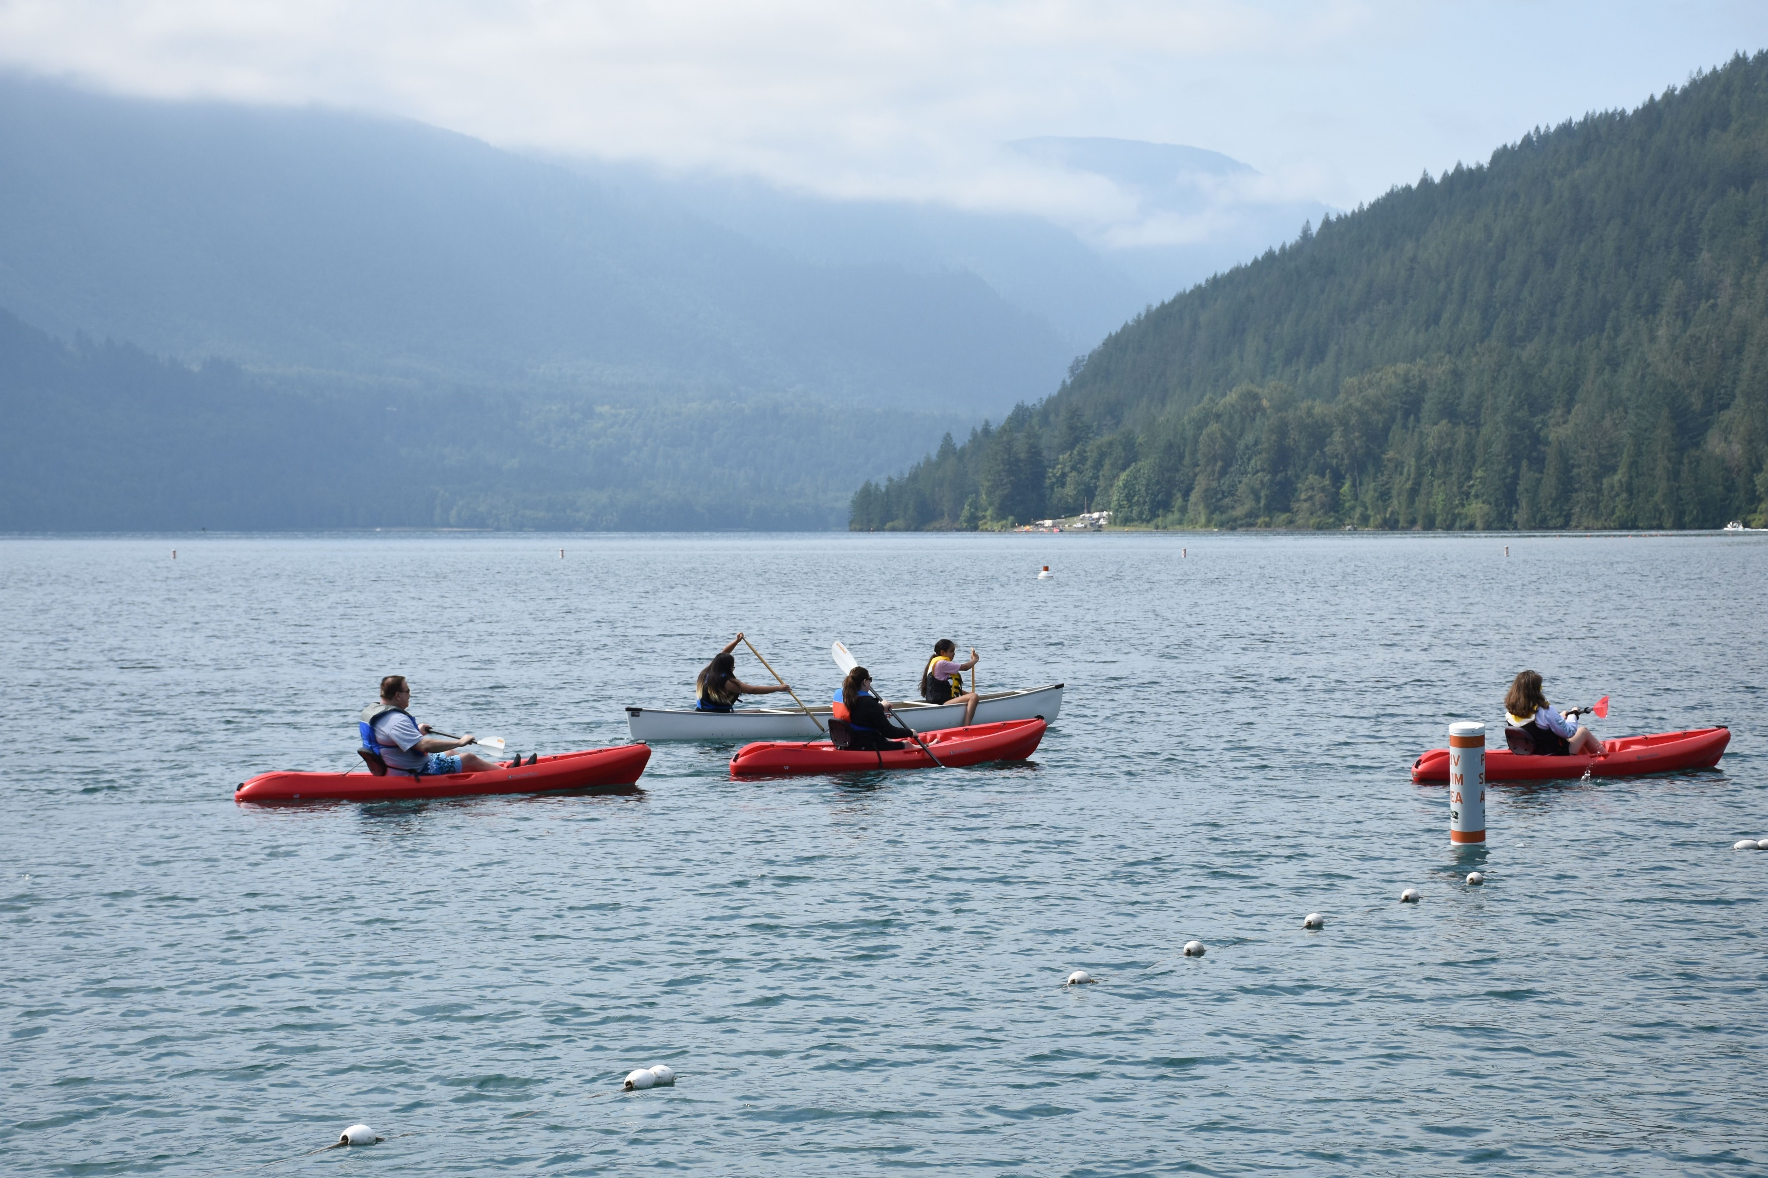
Importance of UNDRIP in Child and Family Services
Cultural Integrity
Family and Community Rights
Free, Prior, and Informed Consent
Jurisdiction and Self-Determination

Slide 22

Strategies for Implementing UNDRIP in Child and Family Services
Continued alignment of laws and policies with UNDRIP
Empowering and Upholding Indigenous jurisdiction and self-determination in child and family services
Using UNDRIP in jurisdiction plans and agreements

Slide 23

Questions & Discussion

Slide 24
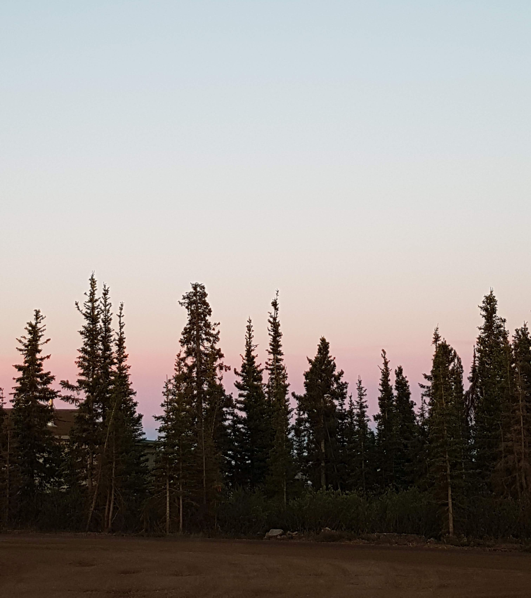
Thank You!
Dawn Johnson
dawn@mandellpinder.com
Judy Wilson
[email]

